Slide 1
iBizAfrica Web Development Final Project

Slide 2
agenda
INTRODUCTION 3
PROBLEM STATEMENT 4
SOLUTION 5
HOMEPAGE 6
OTHER PAGES 7-13

Slide 3
cancerHub Center

Slide 4
Problem
Inadequate facilities
Access to information and awareness

Slide 5
Solution
Create a platform that centralizes;
Access to information on cancer
Access to test screening
Access to consultation and support
Patient management

Slide 6
Tools
Vue.js for frontend
Laravel for backend
Postman for API testing
XAMPP local server and database

Slide 7
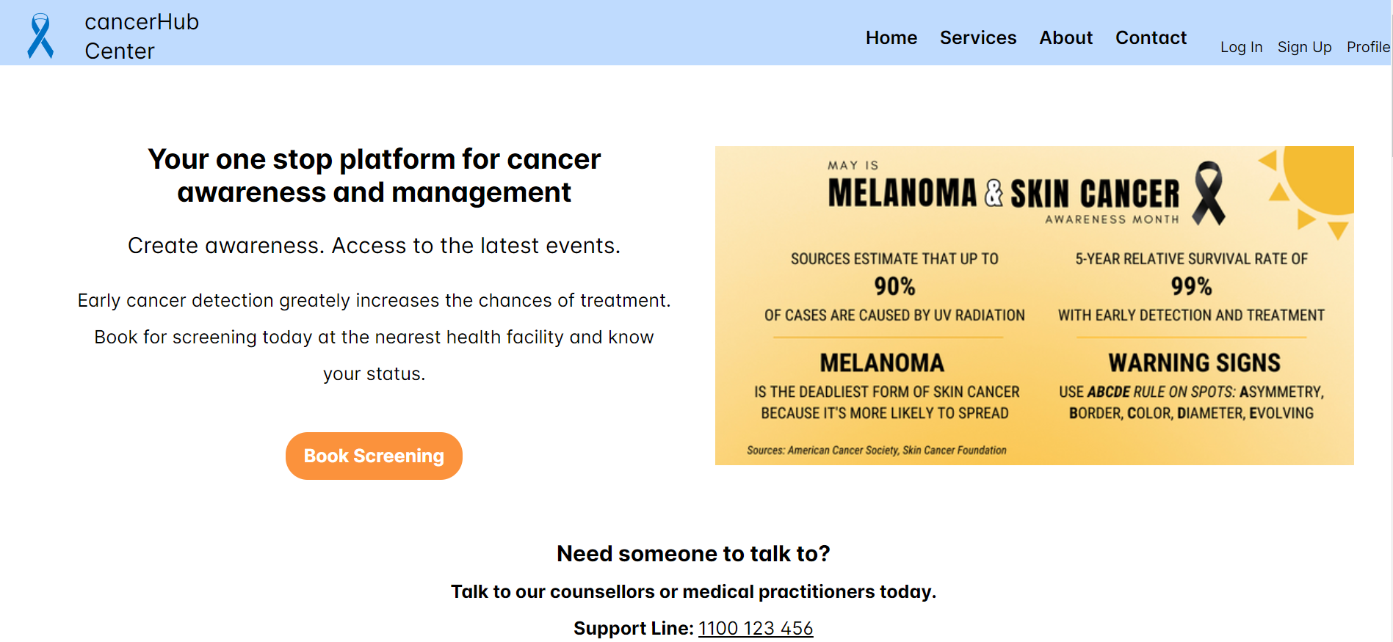
Homepage

Slide 8
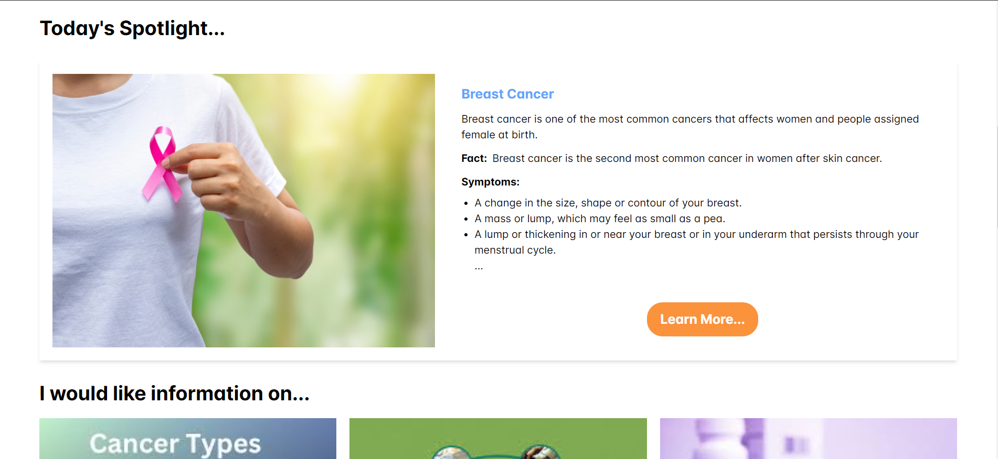

Slide 9


Slide 10
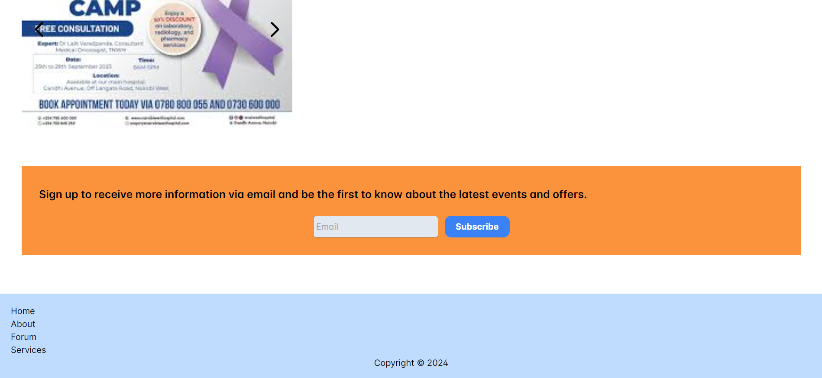

Slide 11
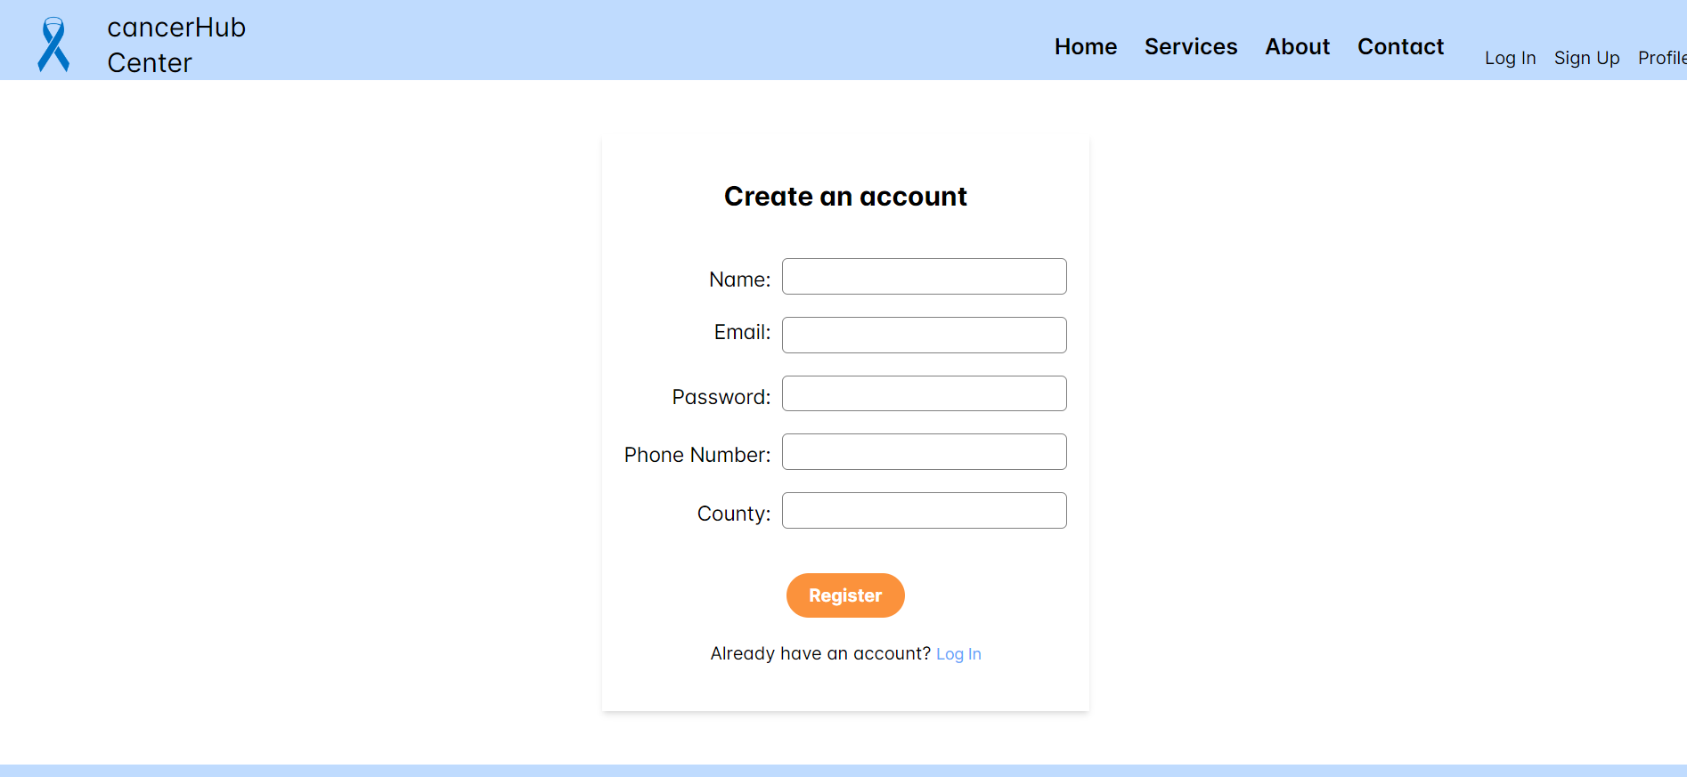

Slide 12
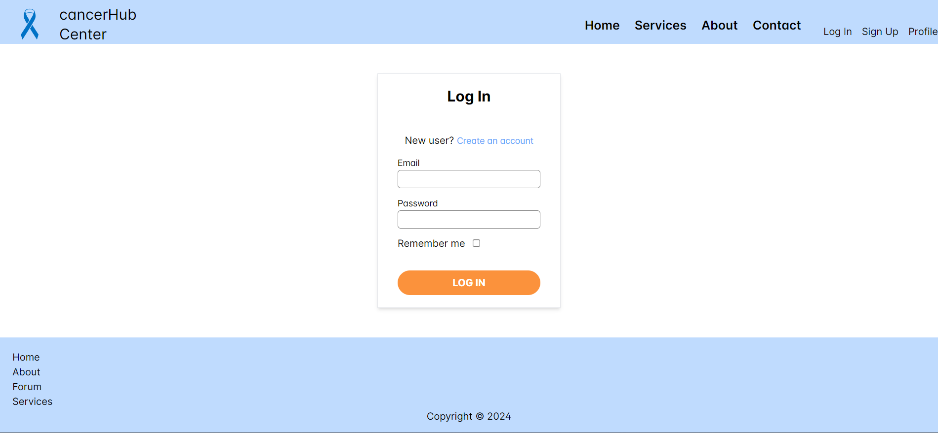

Slide 13
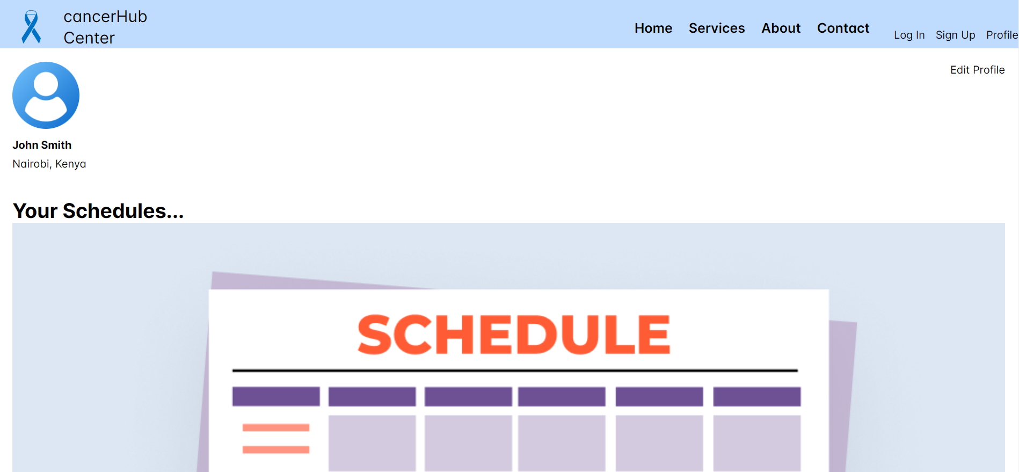

Slide 14
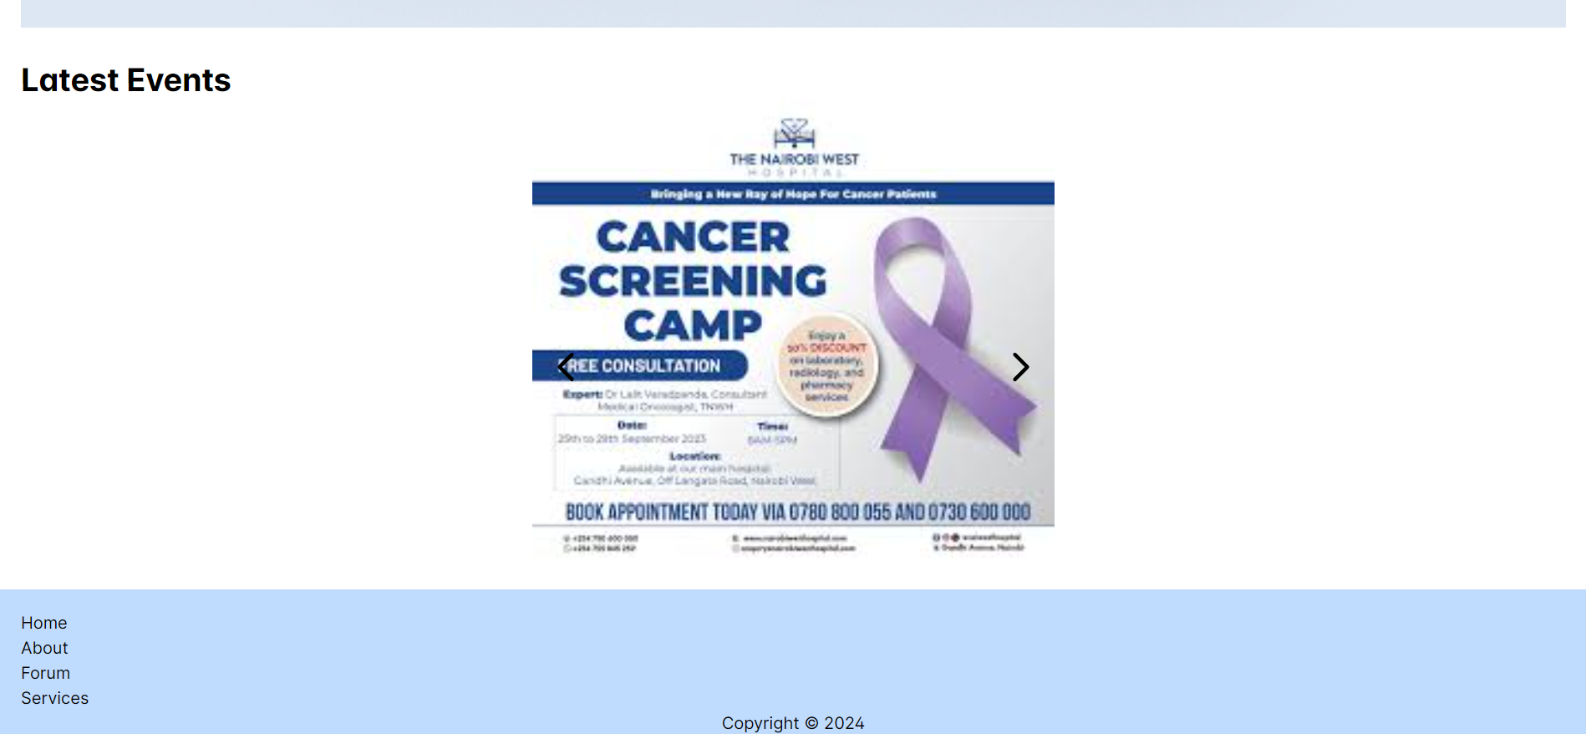

Slide 15
Challenges
Accessing real patients’ data
Integrating payments into the platform
Accessing personal data in the frontend using

Slide 16
thank you

